Slide 1
AUDIO TO SIGN LANGUAGE TRANSLATOR
Under the guidance of:-
Dr. Ashish Kailashchandra Sharma By:- Ankit Jha, Amit Singh,
Rahul Raj, Ankit Sinha
Notes:
Delete this slide when you finish preparing the other slides.

Slide 2
Abstract
This report presents a MOBILE-BASED SIGN LANGUAGE TRANSLATION DEVICE for automatic
translation of Indian sign language into speech in English to assist the hearing or speech impaired people . . to communicate with hearing people.
It could be used as a translator for people that do not understand sign language, avoiding by this way the intervention of an intermediate person and allow communication using their natural way of speaking.
The sign language gesture images are acquired using the inbuilt camera of the mobile phone; vision
analysis functions are performed in the operating system and provide speech output through the inbuilt
audio device.
This is able to recognize one handed sign representations of alphabets (A-Z) and numbers (0-9).The results are found to be highly consistent, with fairly high precision and accuracy.

Slide 3

Introduction
Sign Language is the natural way of communication of hearing or speech-impaired people. A sign is a movement of one or both hands, accompanied with facial expression, which corresponds to a specific meaning.
Although the deaf, hard of hearing and hearing signers can communicate without problems amongst themselves, there is a serious challenge for the deaf community trying to integrate into educational, social and work environments.
The overall goal of this project is to develop a new vision based technology for recognizing and translating continuous sign language to text.
Our system aims at listening to deaf, which means that it could be used as a translator between deaf and people that do not understand sign language, avoiding by this way the intervention of an intermediate person.

Slide 4

Methodology
Audio input on a Personal Digital Assistant(PDA) using python PyAudio module.
Conversion of audio to text using Google Speech API.
Dependency parser for analysing grammatical structure of the sentence and establishing relationship between words.
ISL Generator: ISL of input sentence using ISL grammar rules.
Generation of Sign language with signing Avatar.

Slide 5
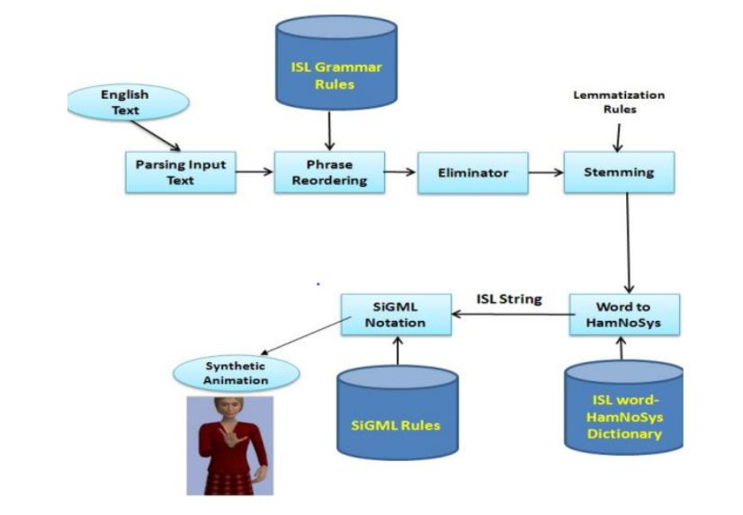
Work flow

Slide 6
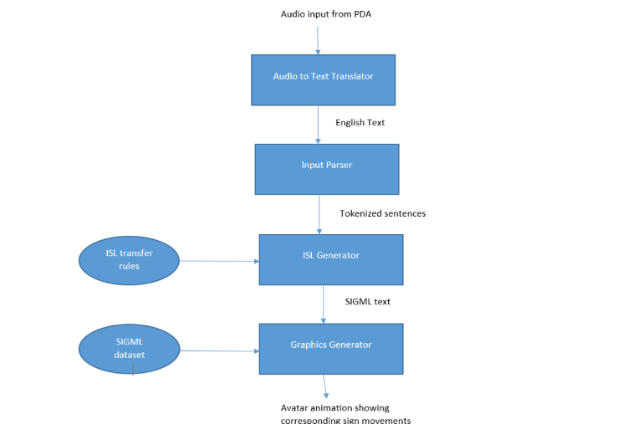
Process flow

Slide 7

BACKGROUND STUDIES
In this Paper [1]Taner Arsan Pattern Matching for Automatic Sign Language Translation System using LabVIEW, International Conference on Intelligent and Advanced Systems 2007 : This paper presents an automatic sign language translator, which is able to translate Malaysian sign language using pattern-matching algorithm.
In this paper [2] Sign language is a visual language that is used by deaf people as their mother tongue. Unlike acoustically conveyed sound patterns, sign language uses body language and manual communication to fluidly convey the thoughts of a person.
In this paper [4] In recent years, research has progressed steadily in regard to the use of computers to recognize and render sign language. Technology is rapidly changing and improving the way the world operates. Barriers for people who are hard hearing are diminishing as projects of the past two decades have unfolded.

Slide 8

OBJECTIVES
To provide information access and services to deaf people in Indian sign language.
To develop a scalable project which can be extended to capture whole vocabulary of ISL through manual and non-manual signs.

Slide 9


problem statement
Since deaf people are usually deprived of normal communication with other people, they have to rely on an interpreter or some visual communication. Now the interpreter cannot be available always, so this project can help eliminate the dependency on the interpreter.

Slide 10
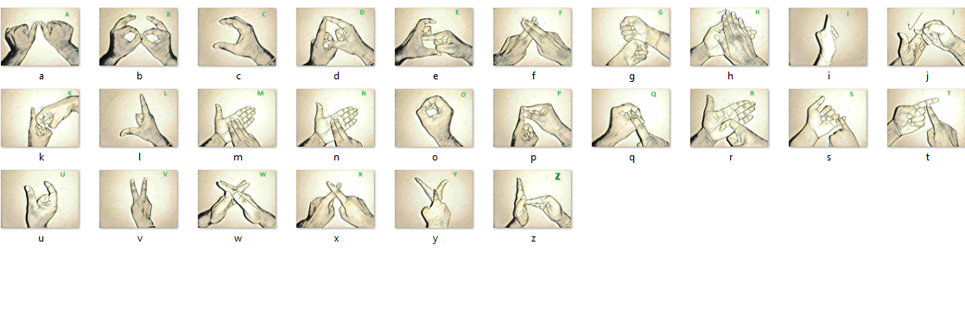
Implementation
Alphabet Representation

Slide 11
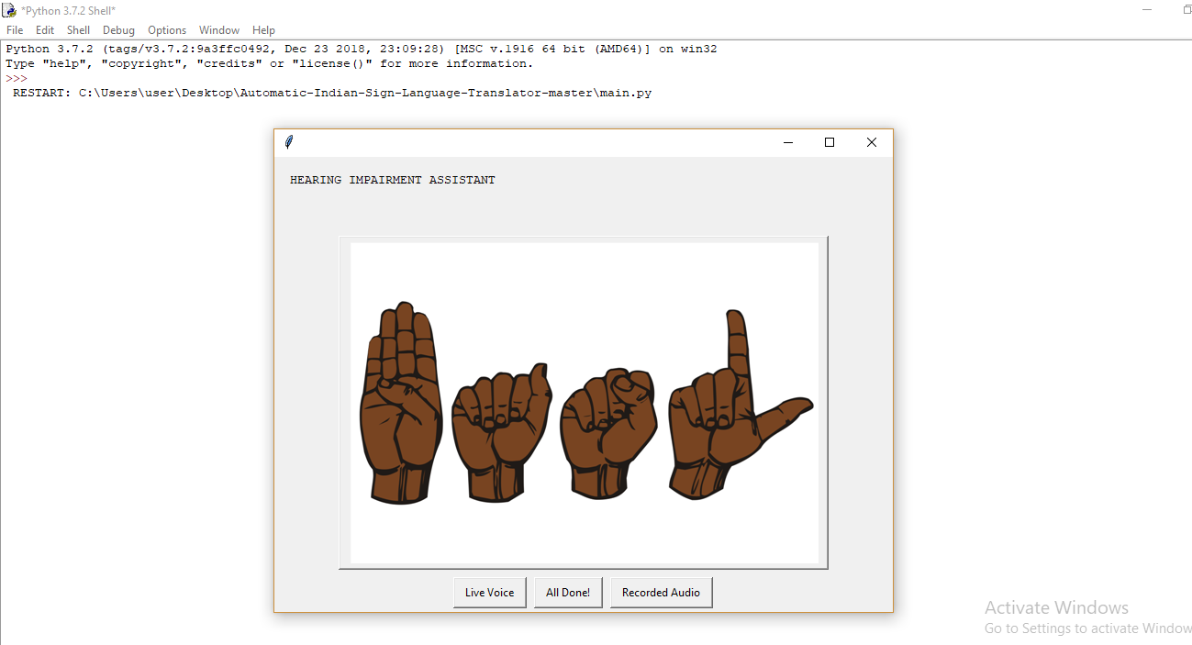
Implementation
Hearing impairment Assistant

Slide 12
THANK YOU

